Slide 1

DT analysis
26.04.2

Slide 2
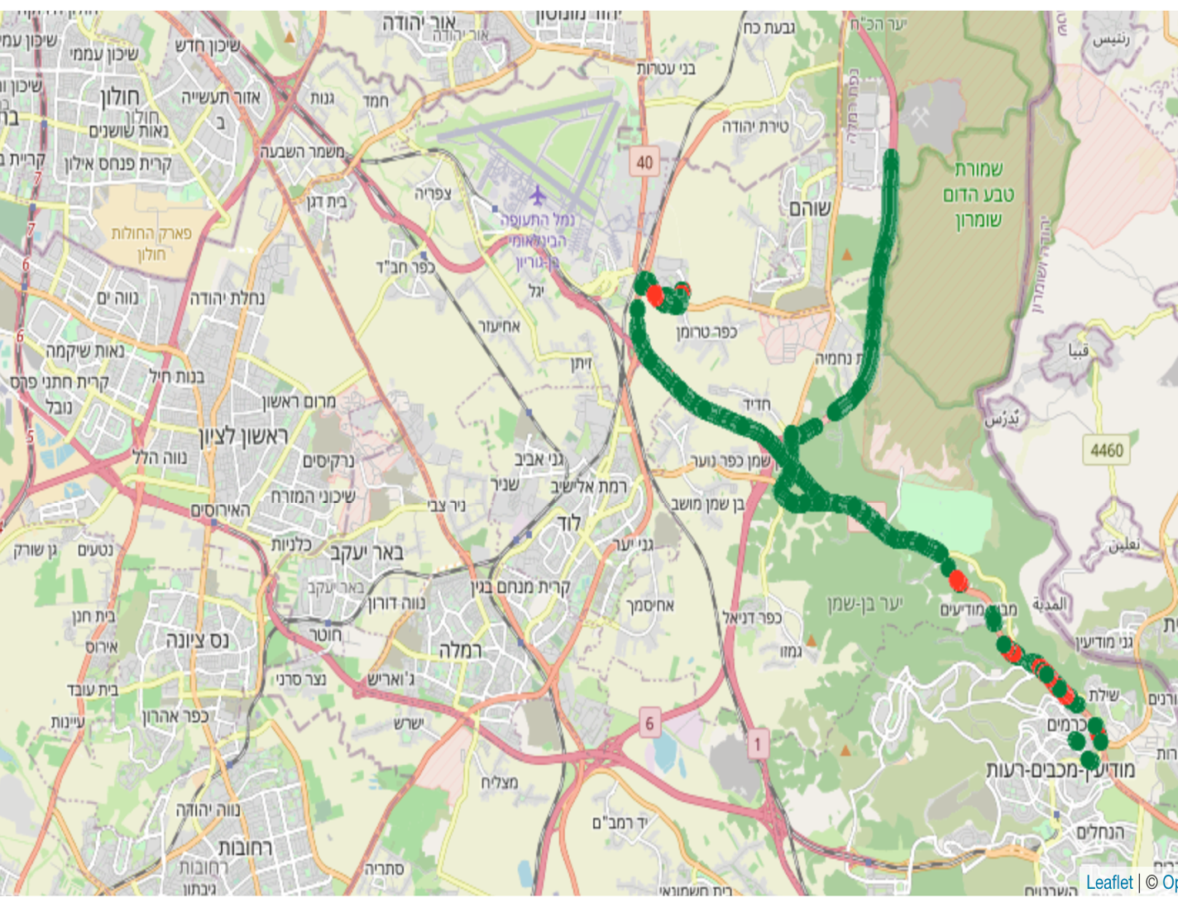
DT Site ID : 40828
Min distance from border 800m , max distance 8km.
42000 Points recorded , There 11% of the dots above -92 threshold.
About 9% were near the border.
Above threshold
Below threshold

Slide 3
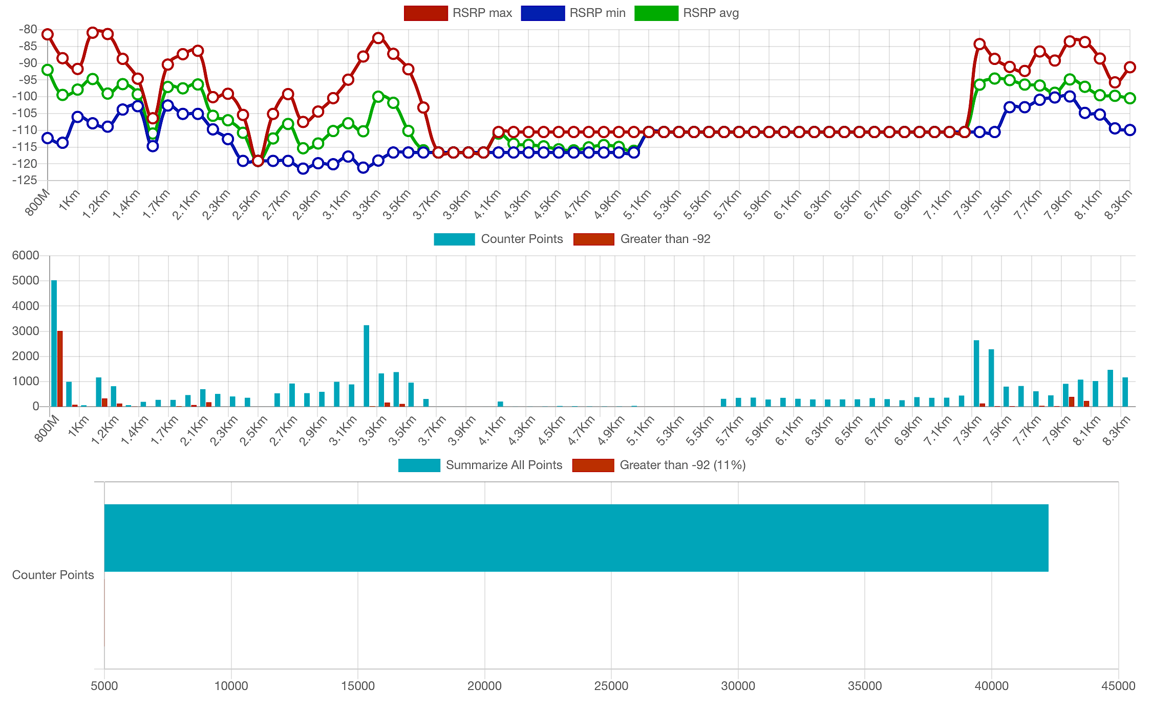
Distance from border
Distance from border

Slide 4
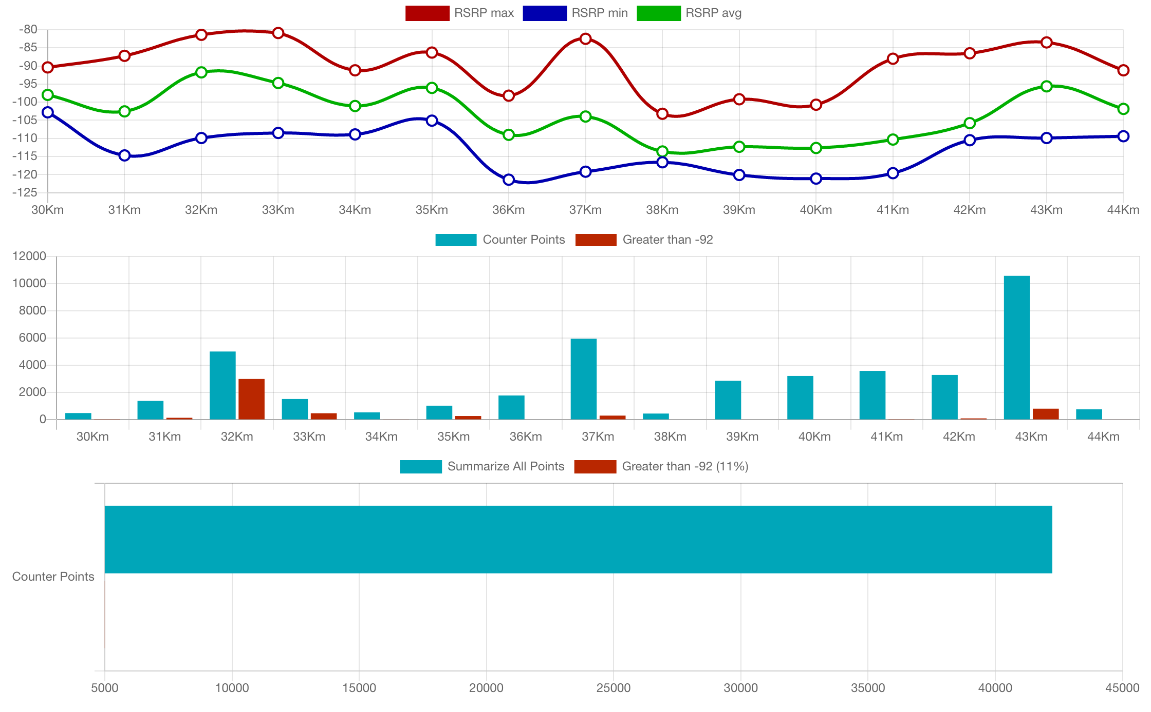
Distance from border
Distance from site

Slide 5
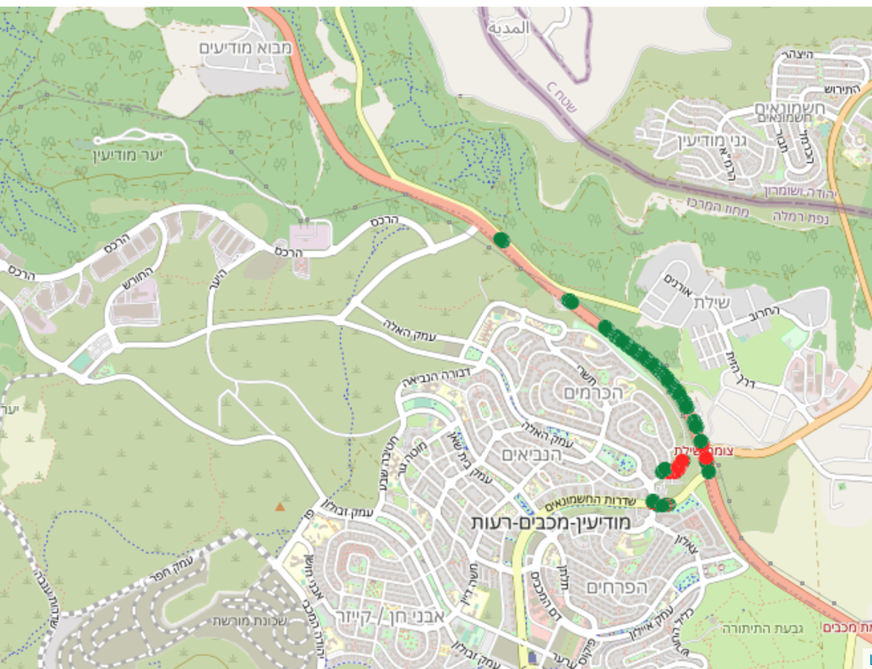
DT Site ID : 29158
Min distance from border 800m , max distance 1.8km.
6000 Points recorded , There 32% of the dots above -92 threshold.
All the threshold were far from the border (1.4km+).
Above threshold
Below threshold

Slide 6
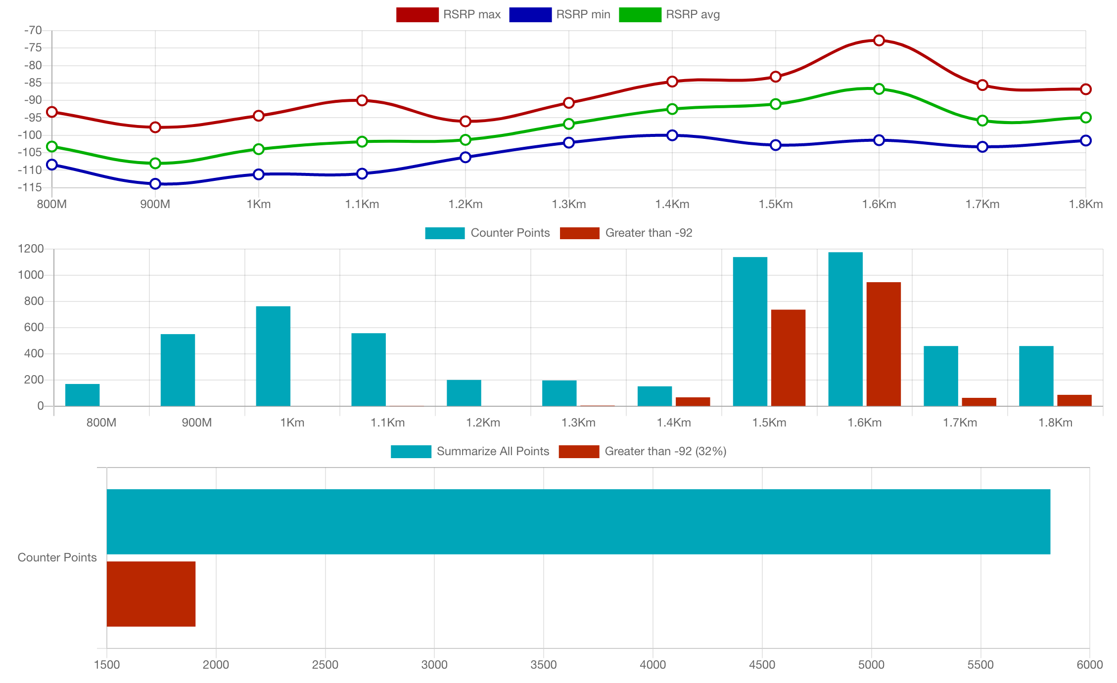
Distance from border
Distance from border

Slide 7
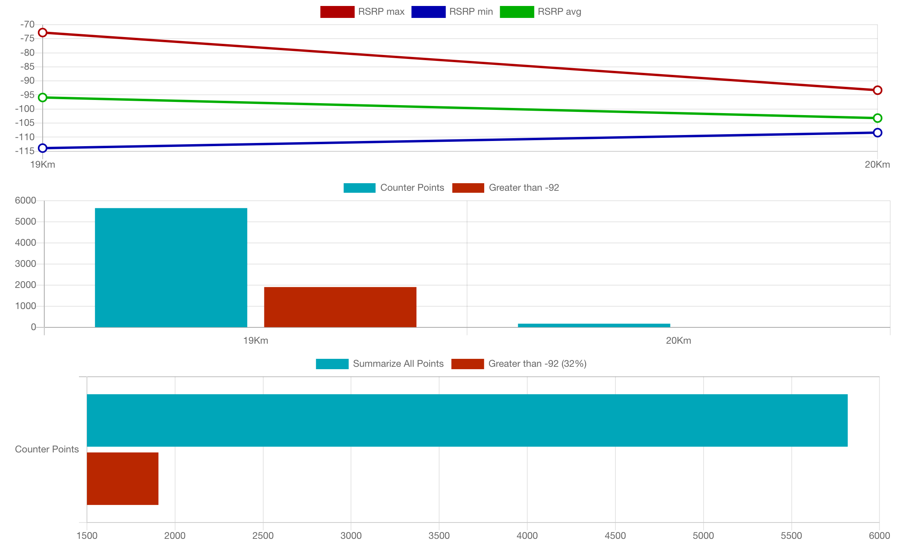
Distance from border
Distance from site

Slide 8
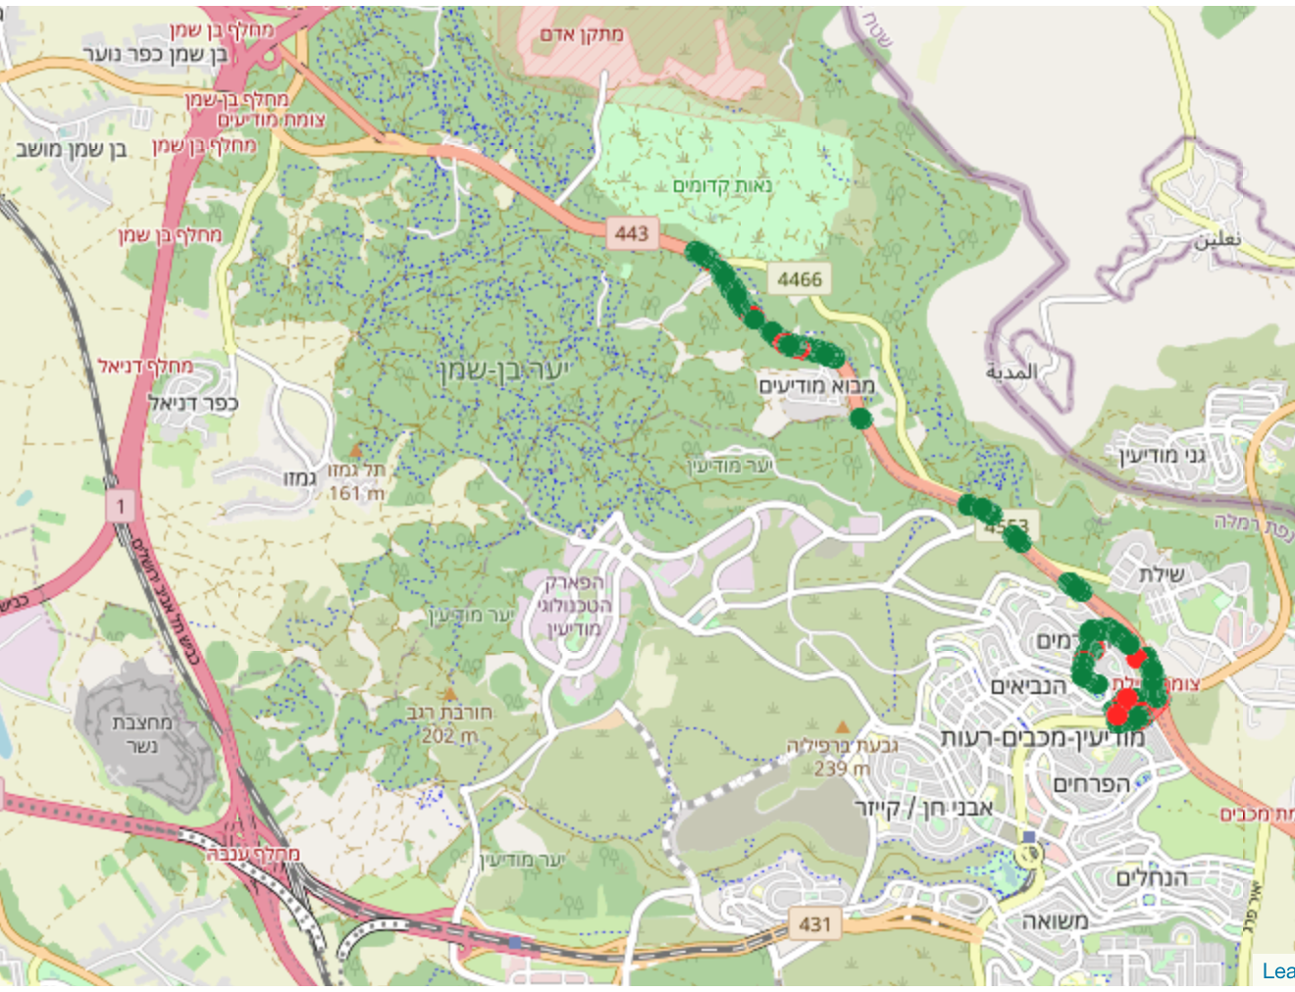
DT Site ID : 40749
Min distance from border 800m , max distance 2.1km.
35000 Points recorded , There 23% of the dots above -92 threshold.
All the threshold were far from the border (1km+).
Above threshold
Below threshold

Slide 9
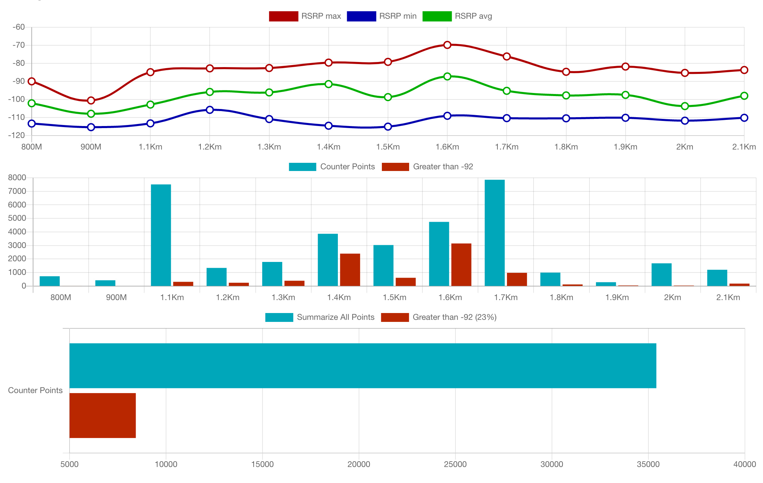
Distance from border
Distance from border

Slide 10
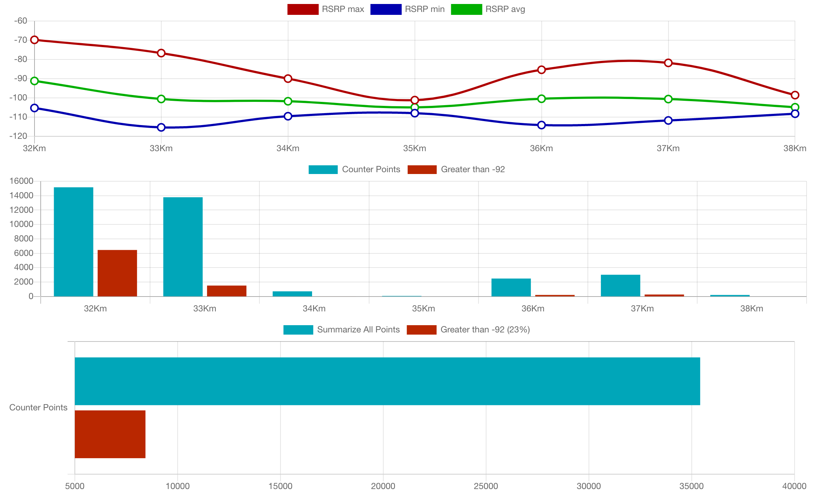
Distance from border
Distance from site

Slide 11
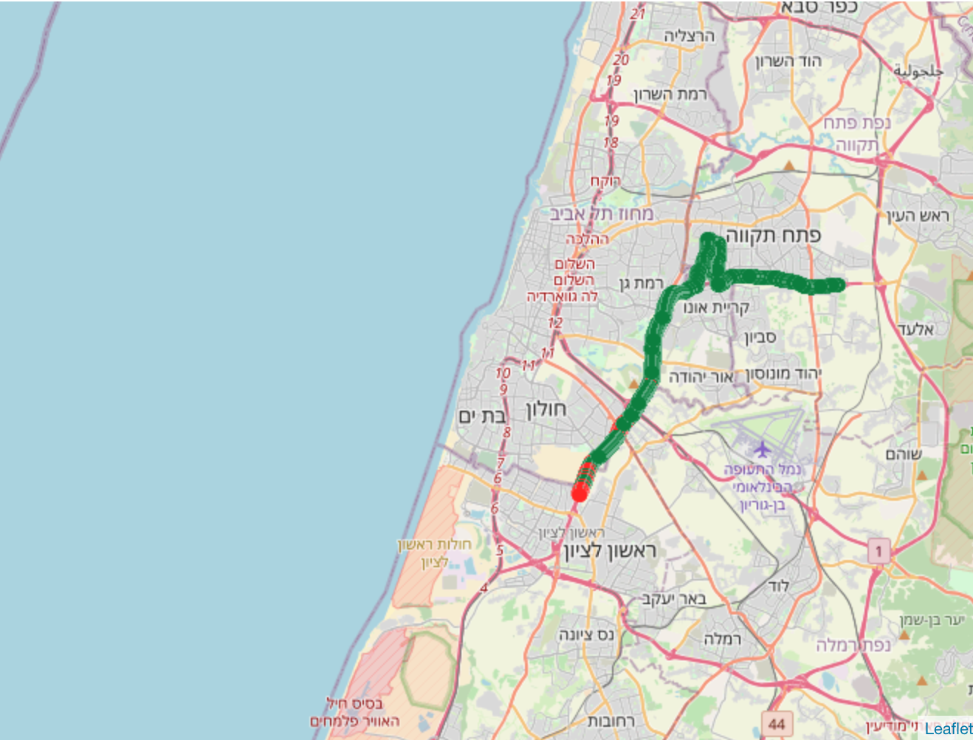
DT Site ID : 41277
Min distance from border 7km , max distance 19km.
50000 Points recorded , There 10% of the dots above -92 threshold.
All the threshold were far from the border (15km+).
Above threshold
Below threshold

Slide 12
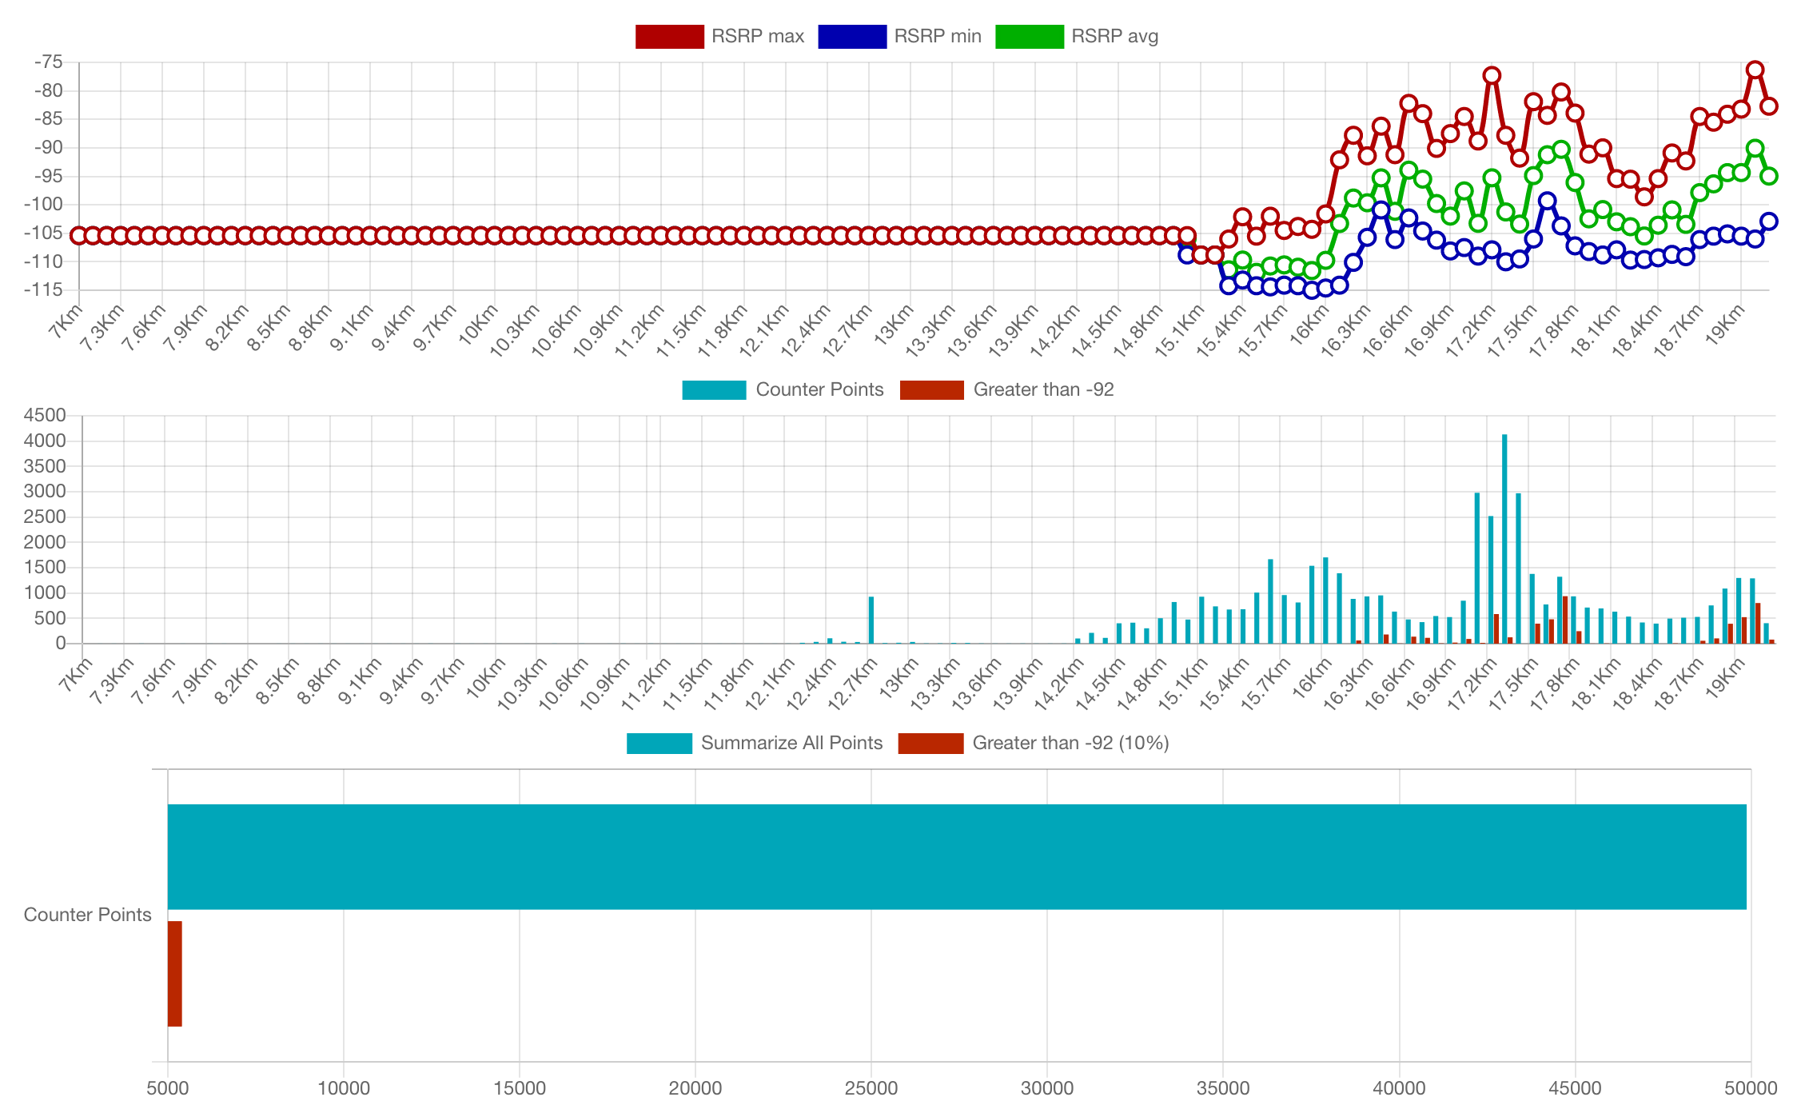
Distance from border
Distance from border

Slide 13
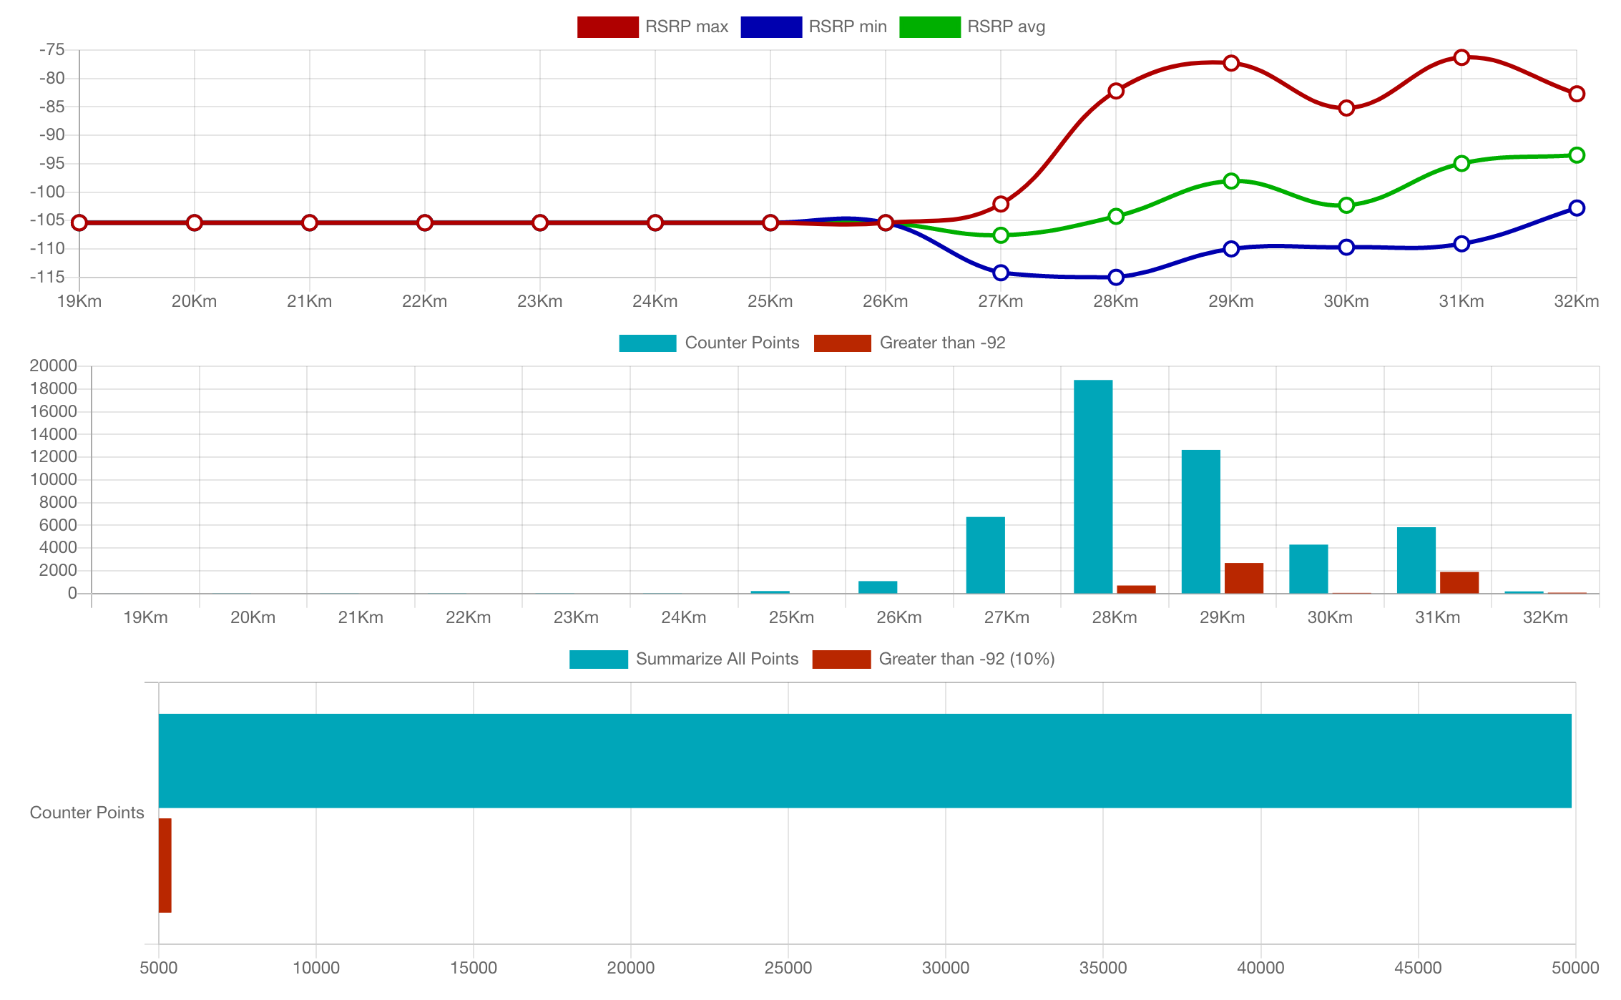
Distance from border
Distance from site

Slide 14
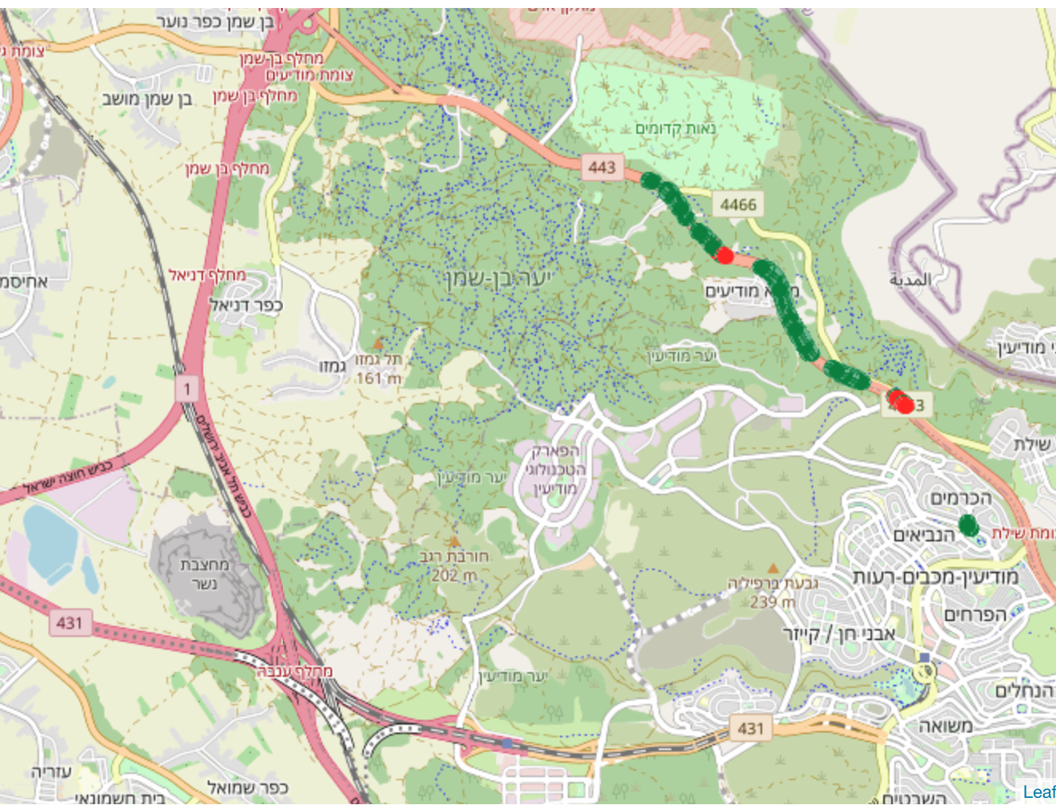
DT Site ID : 41658
Min distance from border 800m , max distance 2.1km.
10000 Points recorded , There 7% of the dots above -92 threshold.
• The threshold point speeded through the whole DT.
Above threshold
Below threshold

Slide 15
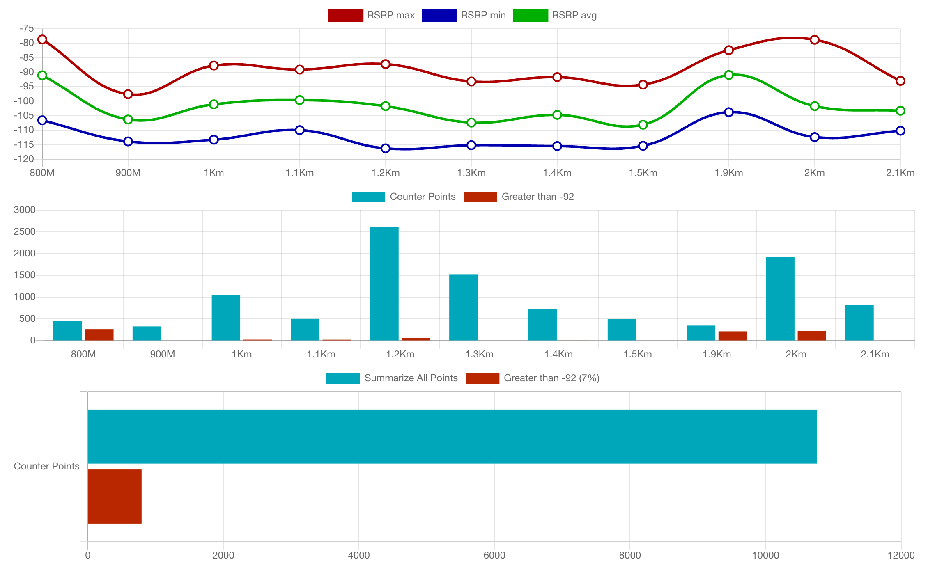
Distance from border
Distance from border

Slide 16
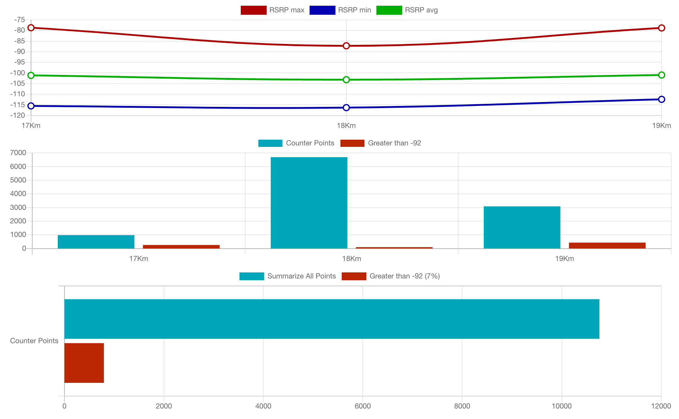
Distance from border
Distance from site

Slide 17
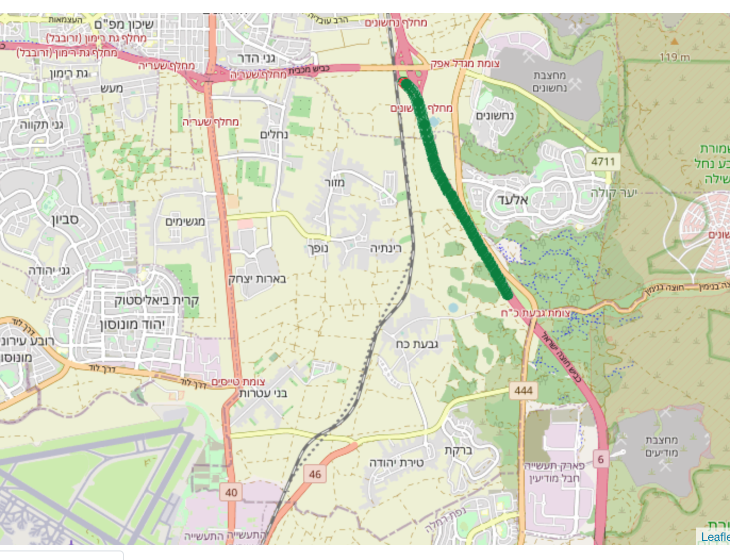
DT Site ID : 42318
Min distance from border 4km , max distance 5.4km.
2800 Points recorded , There 4% of the dots above -92 threshold.
The threshold point was collected on 5.4 km from the border.
Above threshold
Below threshold

Slide 18
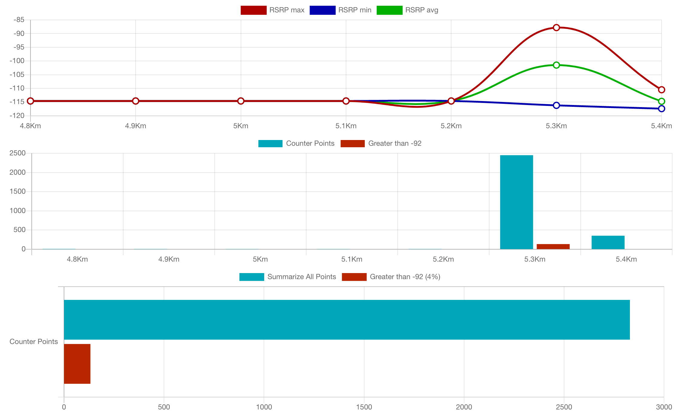
Distance from border
Distance from border

Slide 19
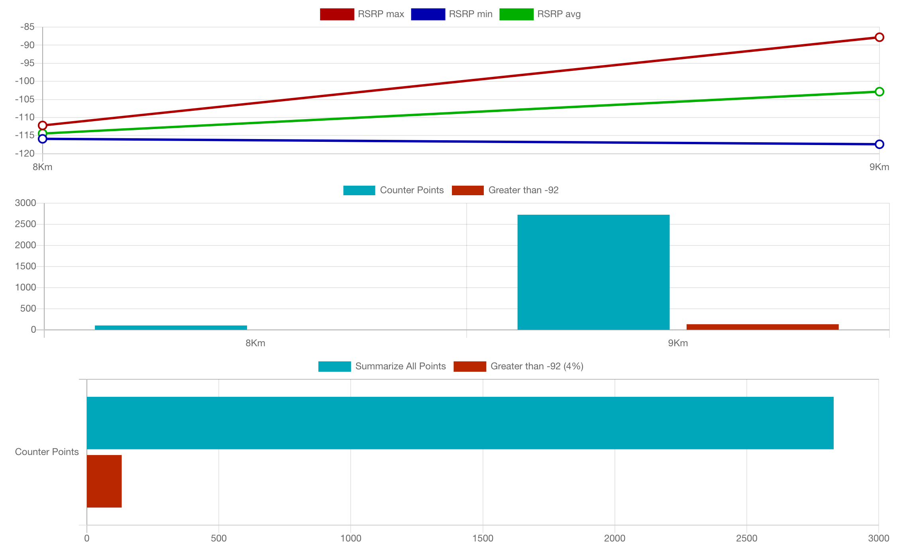
Distance from border
Distance from site

Slide 20
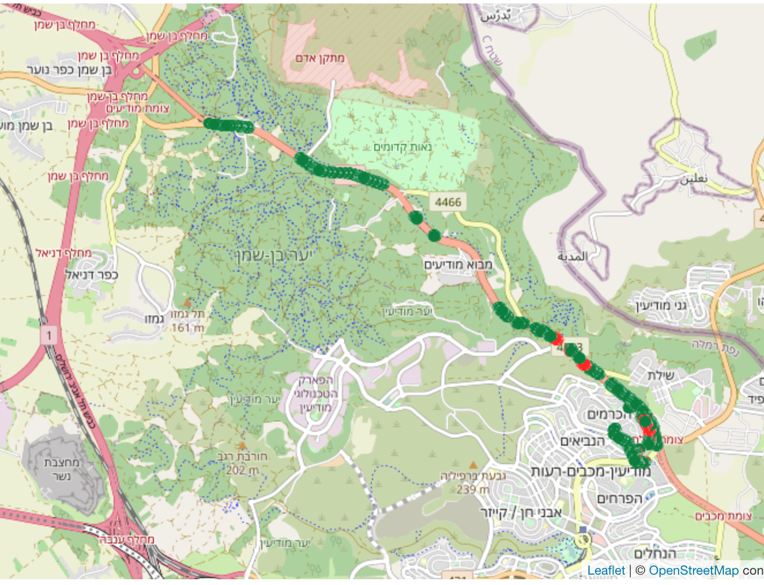
DT Site ID : 42858
Min distance from border 800m , max distance 8.3km.
39000 Points recorded , There 32% of the dots above -92 threshold.
The threshold point was collected on 1.3 km from the border.
Above threshold
Below threshold

Slide 21
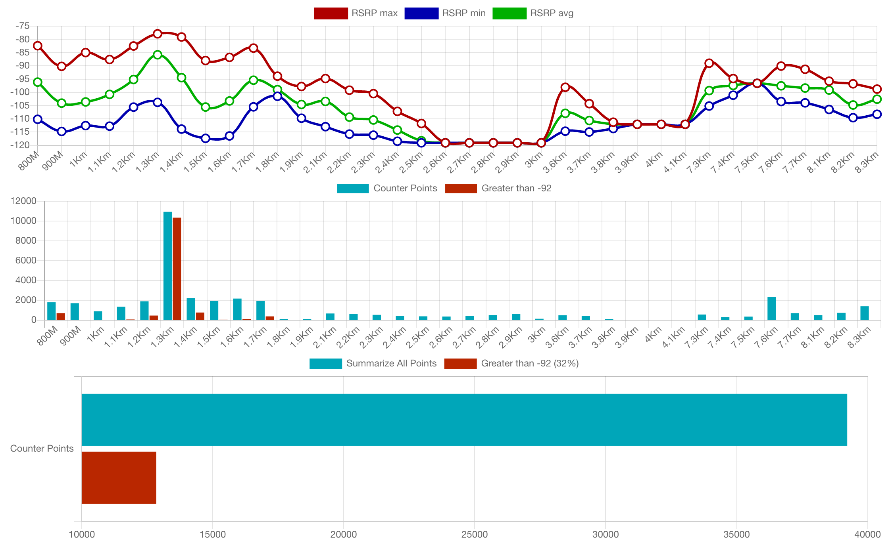
Distance from border
Distance from border

Slide 22
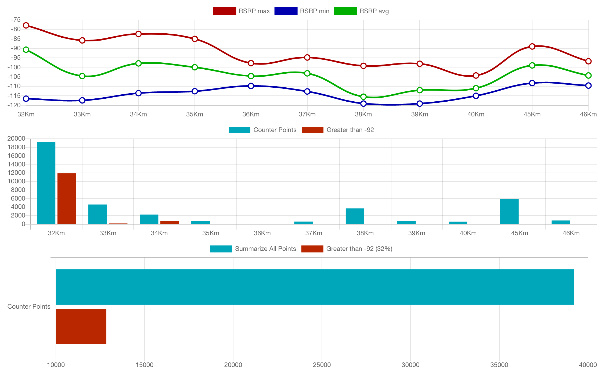
Distance from border
Distance from site

Slide 23
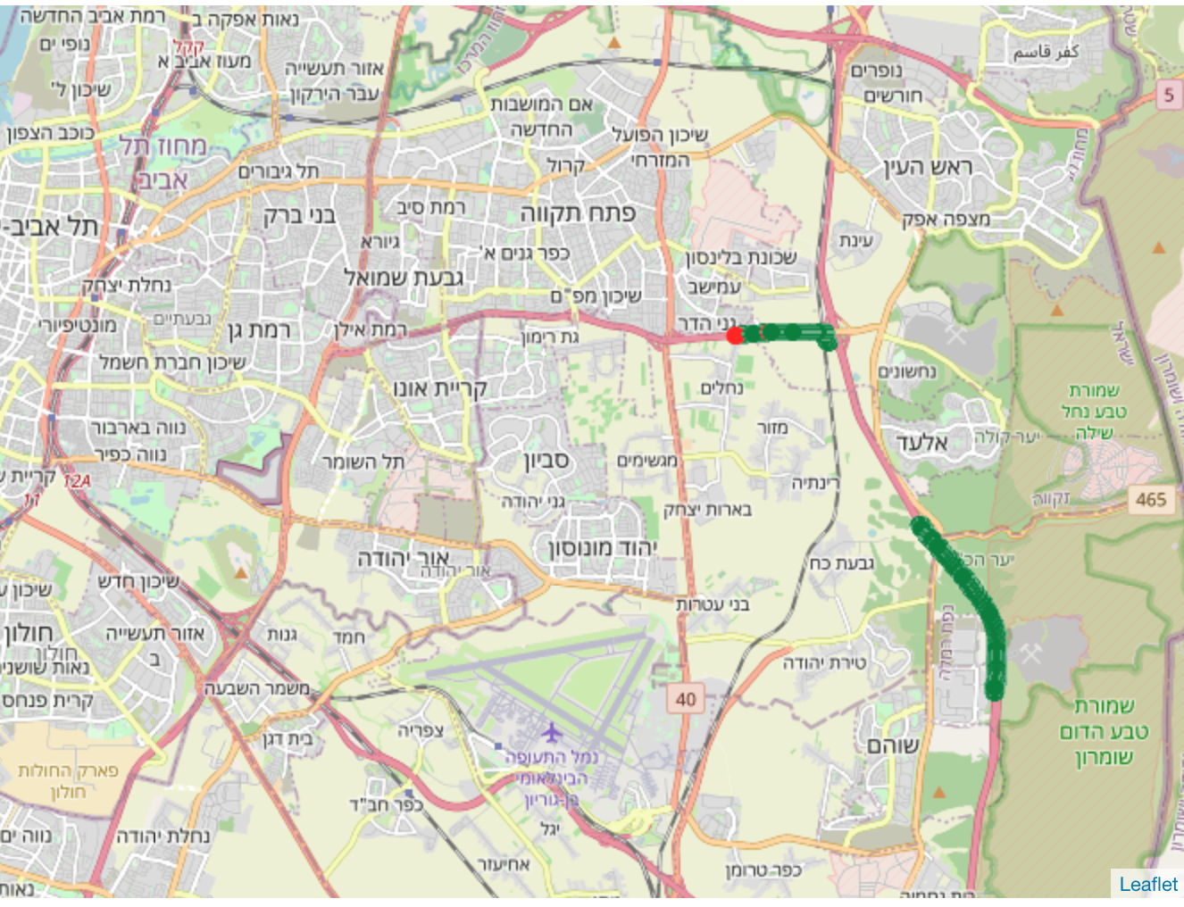
DT Site ID : 43048
Min distance from border 3.2km , max distance 7km.
5500 Points recorded , There 1% of the dots above -92 threshold.
Above threshold
Below threshold

Slide 24
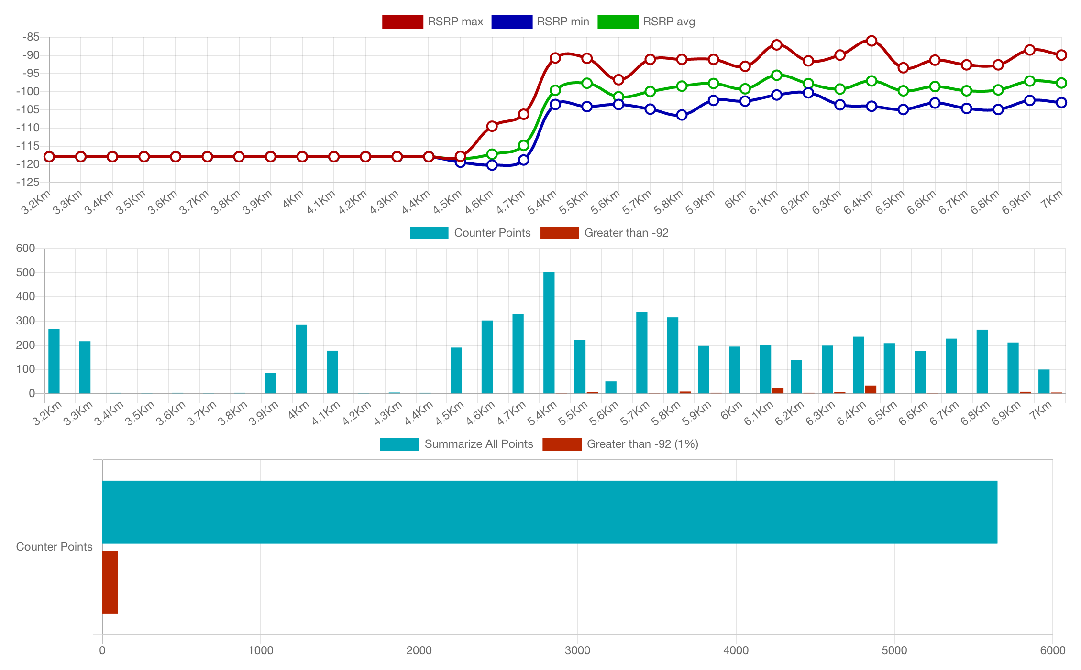
Distance from border
Distance from border

Slide 25
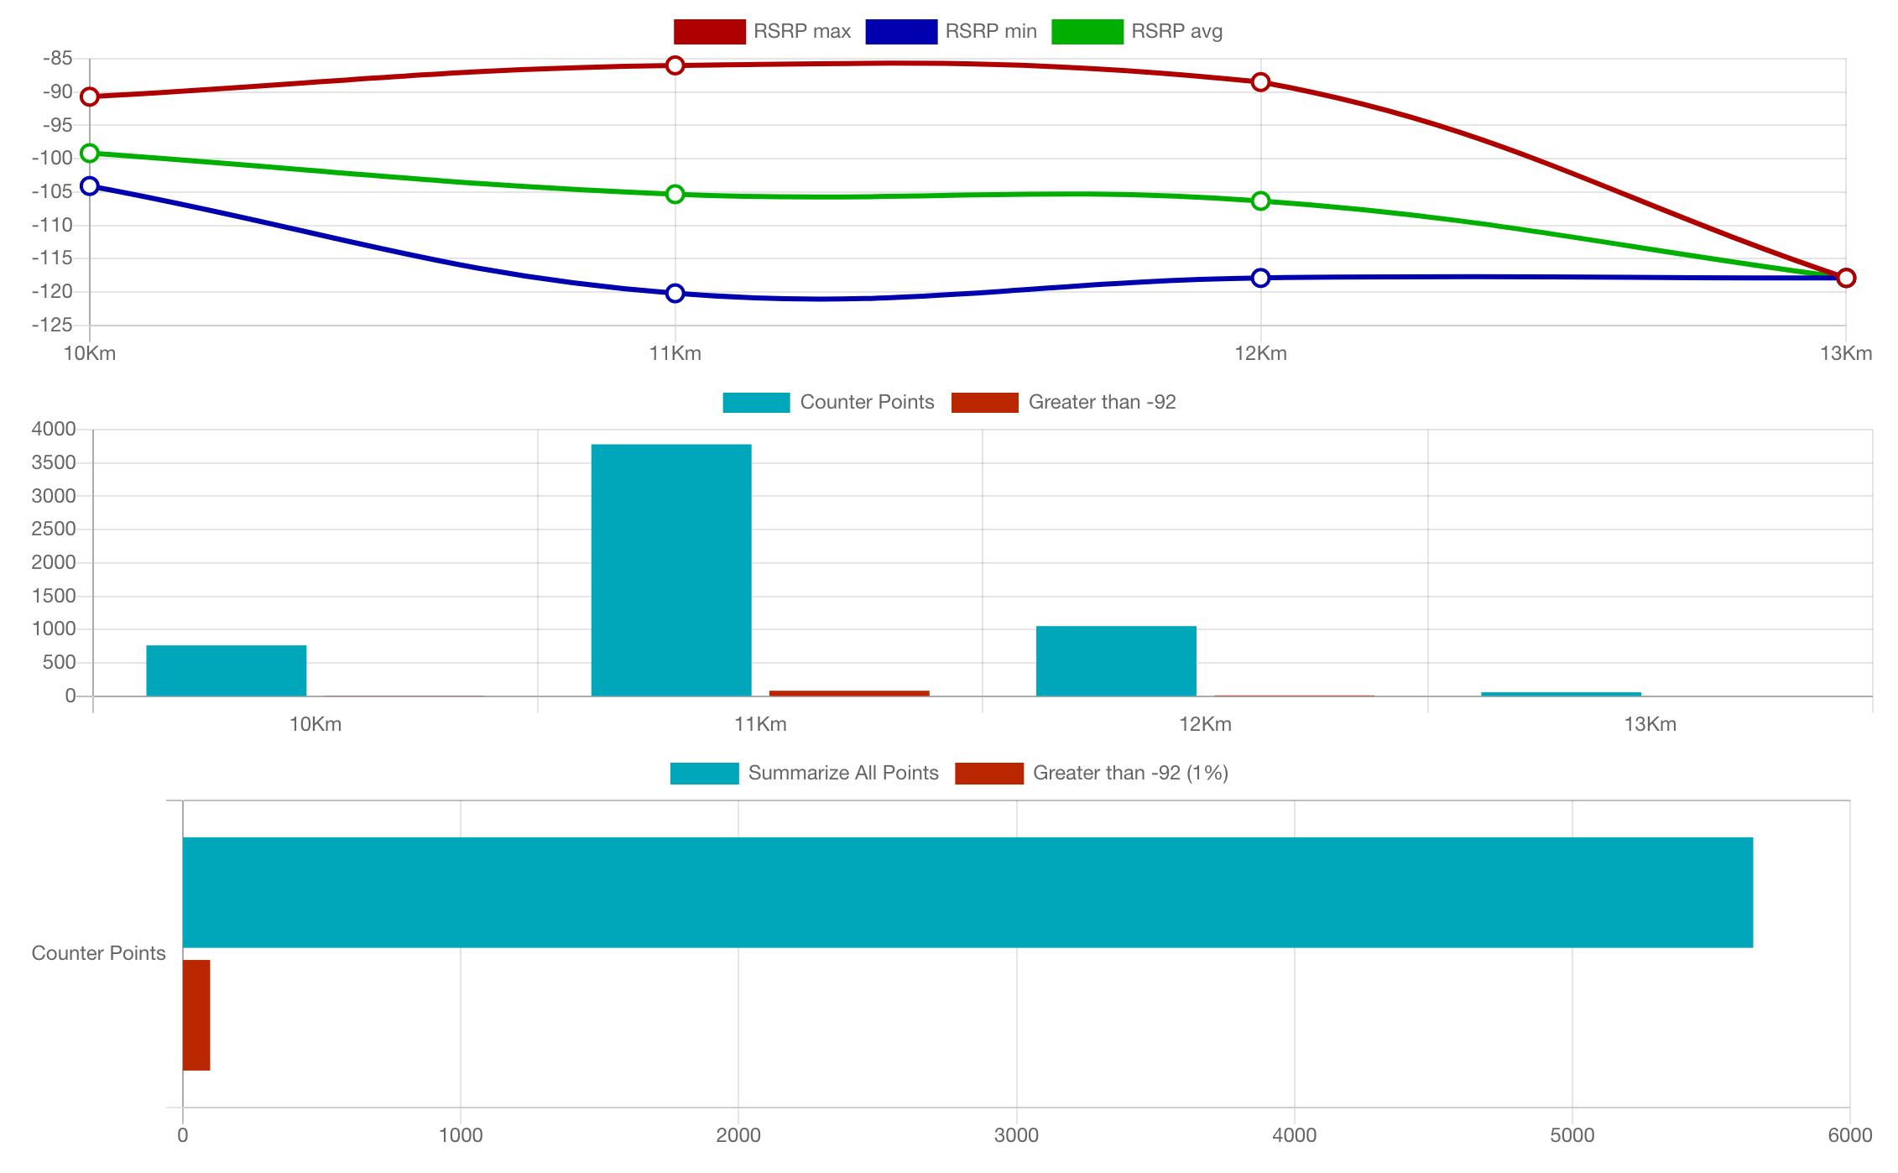
Distance from border
Distance from site

